Slide 1
Smart Ag Software Platform for Autonomous Robots
Team Leader: Alex Clark
Key Concept Holder: Alex Peck
Communications: Chandler Heisler
Webmaster: Kurry Watson
Advisor: Swamy Ponpandi
Client: Colin Hurd
DEC 1609

Slide 2
Presentation Agenda
Colin Hurd and SmartAg
Evolution of Our Project
Deliverables
Project Design
Languages and frameworks
React, Node.js, AWS, Openlayers 3, Bootstrap
Accomplishments
Describing Progress
Testing
Test Videos
Demo
Challenges
DEC 1609

Slide 4
Colin Hurd and SMART AG
Graduated ISU in 2013
Founder and CEO of Agriculture Concepts
Tillage modification for planters
Smart Ag LLC
Enable farm machinery to benefit from internet connection
Fully autonomous equipment
DEC 1609

Slide 5
Our Project - Evolution
Started as hw/sw system to autonomously control tractors in field
Scaled project to not include path finding algorithms after talking to Ag Engineering Professors
We developed a plan for a java based system and presented our idea to our client
After talking with client we decided to go with a web based system
DEC 1609

Slide 6
Our Project - Current State
Create a hardware/software system that attaches to existing agriculture machinery that gives the farmer autonomous and monitoring capabilities
Hardware System (handled by SMARTAG)
Attach to tractor
Access to Motor Control, Gauges, GPS location
Software System (We developed)
Described in future slides
DEC 1609

Slide 7
Deliverables
A functioning UI
monitor the status of their tractor
send the tractor to staging and unloading
sync tractor and nudge it when synced
Draw, save, and load fields
Adjust speed of tractor
Must be easy to use, intuitive, and look appealing
Create access to cloud database that allows UI to store and load data
Add functionality to UI, server, or database as needed at clients request
Very iteration focused

Slide 8
Project Design
Design Shaping Requirements
Communicate to tractor from combine without internet
Push and pull information from cloud with internet
Option to go completely cloud based
DEC 1609

Slide 9
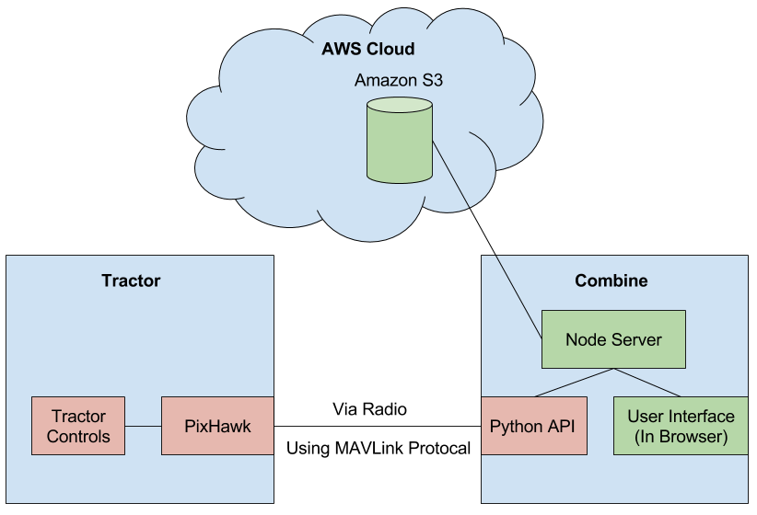
Project Diagram
DEC 1609

Slide 10
Project Diagram
Communicate w/o internet
Access to cloud
Can move server to cloud
Single communication point
Real time communication
DEC 1609

Slide 11
Testing
Feature Testing
Tested all features thoroughly upon creation
Brainstormed and ensured corner cases worked as expected
Tested other features that might be affected by new features
Mock Python API
Created mock python API to simulate tractor connection
Helped us ensure the UI would interface correctly with Tractor
In Field Testing
Client frequently tested the UI in field with live equipment
Feedback was provided consistently from the field tests

Slide 12
React
JavaScript (JS) API
Used to make our GUI
GUI separated into reusable REACT components
Only updates changed components
Used in facebook
DEC 1609
Notes:
AP

Slide 13
AWS
S3 (Simple Storage Service) for cloud storage storage
Files stored as objects within buckets
Data transfer over SSL and encryption of data when uploaded
Full REST APIs and SDKs
Deeply integrated with other AWS services
DEC 1609

Slide 14
OpenLayers 3
Different Layers
Able to refresh just one layer
Satellite view
Pins, Polygons, Pictures
Load points from json objects
Notes:
AP

Slide 15
Node.js
Event-driven
Asynchronous non-blocking I/O
Lightweight and efficient
Incredibly popular and still growing
Express.js
DEC 1609

Slide 16
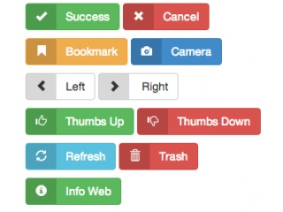
Bootstrap
Browser compatibility
Responsive design
Insanely popular
Easy to use
Looks great
DEC 1609

Slide 17
Milestones
Create GUI
Sending commands that were accepted through GUI
All data saved and stored in the cloud
DEC 1609

Slide 19
Challenges
Project setup and maintenance
Learning what to use
Version control techniques
Constant Integration Development Difficulties
After creating the basic GUI, we were constantly developing and changing as needed by client
Would not know for sure what we would be working on two weeks out
Lead to a lot of changes and refactoring during development
Software Integration without Hardware readily available
Working with large tractors, you cannot just run them every time you submit a fix
Developing software to interact with it without testing it
Mocking up outputs for hardware

Slide 20
Conclusion
Colin Hurd and SmartAg
Evolution of Our Project
Deliverables
Project Design
Challenges
Languages and frameworks
React, Node.js, AWS, Openlayers 3, Bootstrap
Accomplishments
Describing Progress
Testing
Test Videos
Demo
DEC 1609

Slide 21
Questions?
If you have any comments or suggestions, please email us at
DEC1609@iastate.edu
Thank You
DEC 1609

